Slide 1


E-commerce Sentiment Analysis
Automating Feedback Intelligence with NLP

Slide 2

The Challenge
Manual review of thousands of comments is slow, expensive, and inconsistent. We need speed to save customer satisfaction.

Slide 3

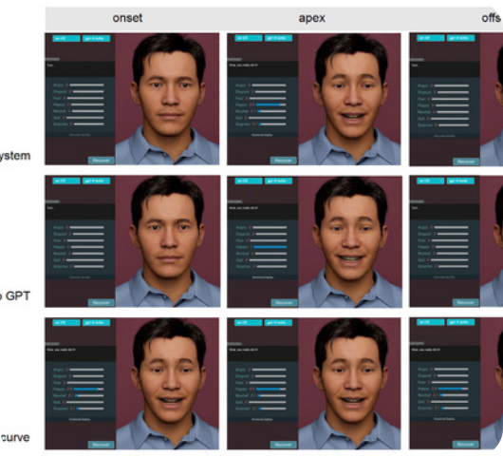


Automation Pipeline
Using Python and Natural Language Processing (NLP), we built a pipeline to ingest raw e-commerce reviews and output actionable data.
1. Data Ingestion
Reading massive .xlsx datasets with 8,000+ entries.
2. Sentiment Mapping
Algorithmic segregation into Positive & Negative labels.

Slide 4
Analysis Scale
8,005
Massive Scale Efficiency
The Python script processed this entire dataset in less than 5 seconds, identifying critical sentiments that would take a human team days to read.
TOTAL COMMENTS ANALYZED

Slide 5
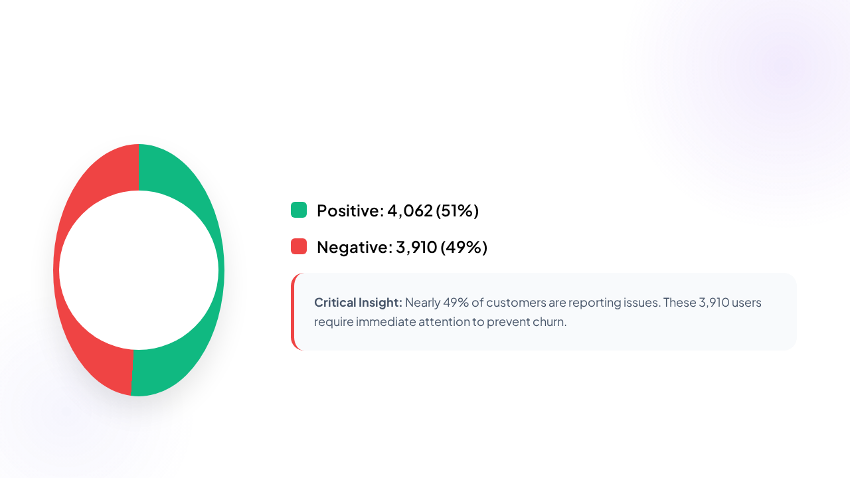
Sentiment Distribution

Slide 6







Project Deliverables
NLP Model
Critical List
Master Data
Python script `nlp_model.py` for automated daily sentiment tracking.
Isolated list of 3,910 negative comments for immediate service recovery.
Cleaned CSV dataset ready for Tableau & PowerBI Dashboarding.

Slide 7

Questions?
E-commerce Sentiment Analysis Complete
DATA SCIENCE | PROJECT M2

Slide 8



Image Sources
https://www.mdpi.com/sensors/sensors-25-05117/article_deploy/html/images/sensors-25-05117-g008-550.jpg
Source: www.mdpi.com
https://static.vecteezy.com/system/resources/previews/052/382/919/non_2x/feedback-emoji-bad-and-good-review-emoticon-emoji-and-smile-emotions-scale-feedback-concept-design-set-happy-and-sad-reaction-mood-faces-for-survey-rating-icons-vector.jpg
Source: www.vecteezy.com
https://flowium.com/wp-content/uploads/2024/12/Best-Customer-Review-Platforms-1-1024x427.jpg
Source: flowium.com

